Slide 1
Computer Graphics Vectors
László Szécsi szecsi@iit.bme.hu
AIT

Slide 2
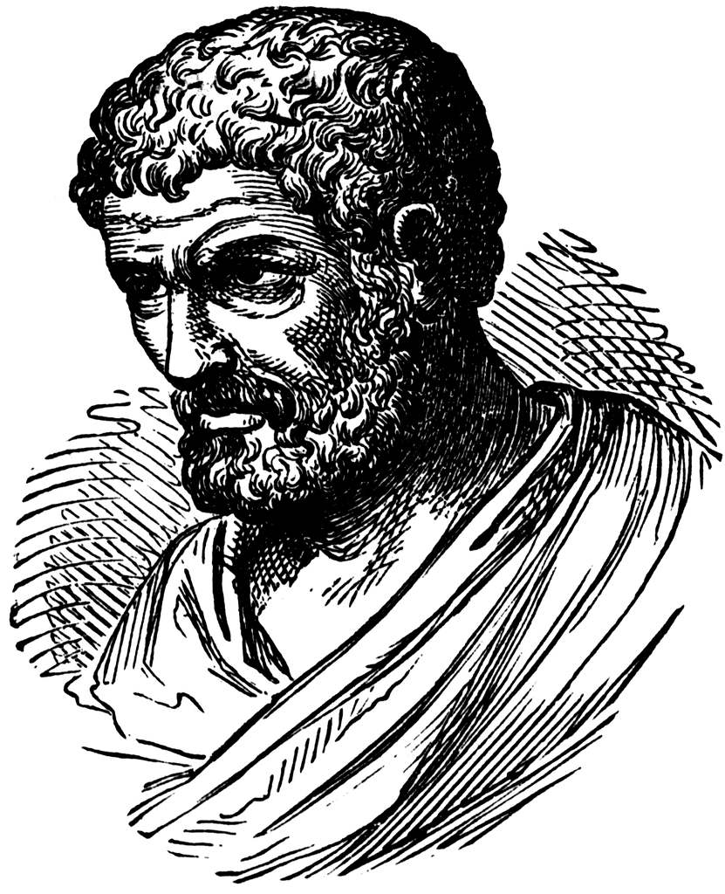
Euclid
Notes:
Father of geometry.

Slide 3
Euclidean geometry - axioms
Exactly one straight line can be drawn through two points.
Exactly one straight line fits any line segment.
Exactly one circle can be drawn with a given point as center, and distance as radius.
Any two right angles are equal.
For any given straight line and point, exactly one straight line can be drawn that goes through the point and has no common point with the line.
Two things equal to the same thing are equal to each other.
Two equal things doubled are also equal.
Notes:
Computer graphics works with shapes. The field of mathematics that describes shapes is geometry, so geometry is essential in computer graphics.
Geometry, like other fields of formal science, has axioms that are based on experience and cannot be argued but are accepted as true statements without arguments. From axioms other true statements, called theorems, can be deducted with logic reasoning.
For example, axioms of the Euclidean geometry include the postulates listed in the slide. Axioms have two purposes, on the one hand, they are accepted as true statements. On the other hand, axioms implicitly define basic concepts like points, lines etc. because they postulate their properties.
Based on the axioms and the applied tools, there are several different geometries that are different models of the world. Everybody knows the Euclidean geometry of the plane and of the space. We know that it is metric, i.e. we can talk of the distance between objects and size is an important concept in it. In Euclidean geometry parallel lines do not intersect, that is, a point at infinity is not part of the Euclidean plane.
However, if we define axioms differently, we can add points at infinity to the plane making all lines, even parallel lines, intersecting. Clearly, this is a different geometry with different axioms and theorems, which is called the projective geometry. Projective geometry is not metric since distance cannot be defined in it. The reason is that the distance from points at infinity is infinite, but infinity is not a number.

Slide 4
Concepts in Euclidean geometry
point, straight line → plane, intersection, going through
line segment, circle→ distance, translation
length → double (half, third) of the length
circumference, area
center of mass
Notes:
There are some base geometric concepts relations that are defined by the axioms. Please note that these are all concepts of geometry. You can do geometry with a straightedge and a compass, without even knowing what a number is.

Slide 5

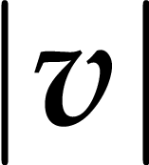
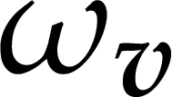

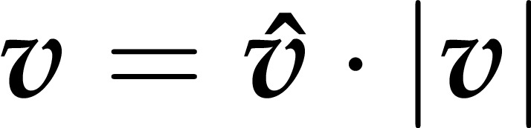
Vector
in geometry: vector = translation
length
direction
we rarely work with directions
rather with unit vectors of given direction
Notes:
Points or sets of points can be translated. A translation has direction and length. By definition, we call that a vector. Thus, translations and vectors are, in geometry, one and the same thing.
The length is denoted by the absolute value of the vector.
We almost never use the direction-of-vector notation, as that introduces variables that neither scalar numbers nor vectors. Instead, we like to work with unit-length vectors to indicate directions. The caret (or hat) over a vector variable name means a unit-length vector.

Slide 6
Vectors and points
if there is an origin specified
every point has an associated vector
point
position vector
origin
Notes:
If we select a special reference point, called the origin, then every point has a unique vector that translates the origin to there. From another point of view, every vector unambiguously defines a point that is reached if the origin is translated by this vector. Such vectors are called position vectors. The fact that there is a one-to-one correspondence between points and position vectors does not mean that points and vectors would be identical objects. Can you add two points i.e. two cross-marks on a sheet of paper? No. Can you add their position vectors one you also specified an origin? Sure!

Slide 7


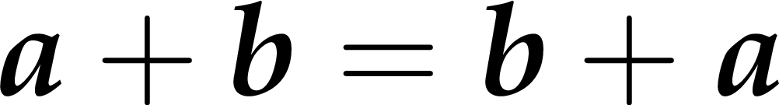
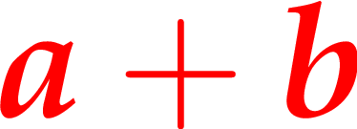
Vector addition
commutative
associative
Notes:
Concerning vector operations, we can talk of addition that means the execution of the two translations one after the other. The resulting translation is independent of the order, so vector addition is commutative (parallelogram rule). If we have more than two vectors, parentheses can be rearranged so it is also associative.

Slide 8


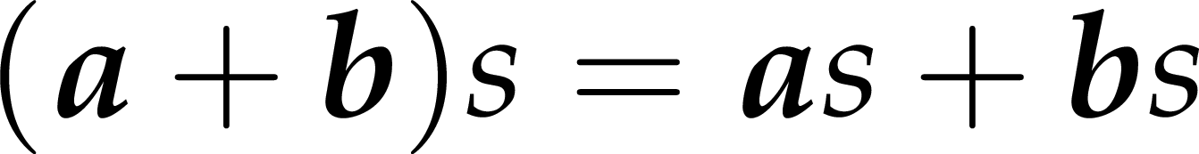
Vector scaling
distributive with addition
Notes:
The length of a vector can be modified by scaling – which is multiplication of a vector by a scalar. The direction is unchanged – albeit if the scalar is negative, the vector is reversed.

Slide 9
Linear combinations of vectors
Notes:
If vectors can be scaled and added, then it is possible to take a weighted sum of multiple vectors. Such a construct is called a linear combination. Linear combination are instrumental in both the definition of coordinate systems and point sets like curves. It all comes down to the rules or formulas of selecting the coefficients.

Slide 10
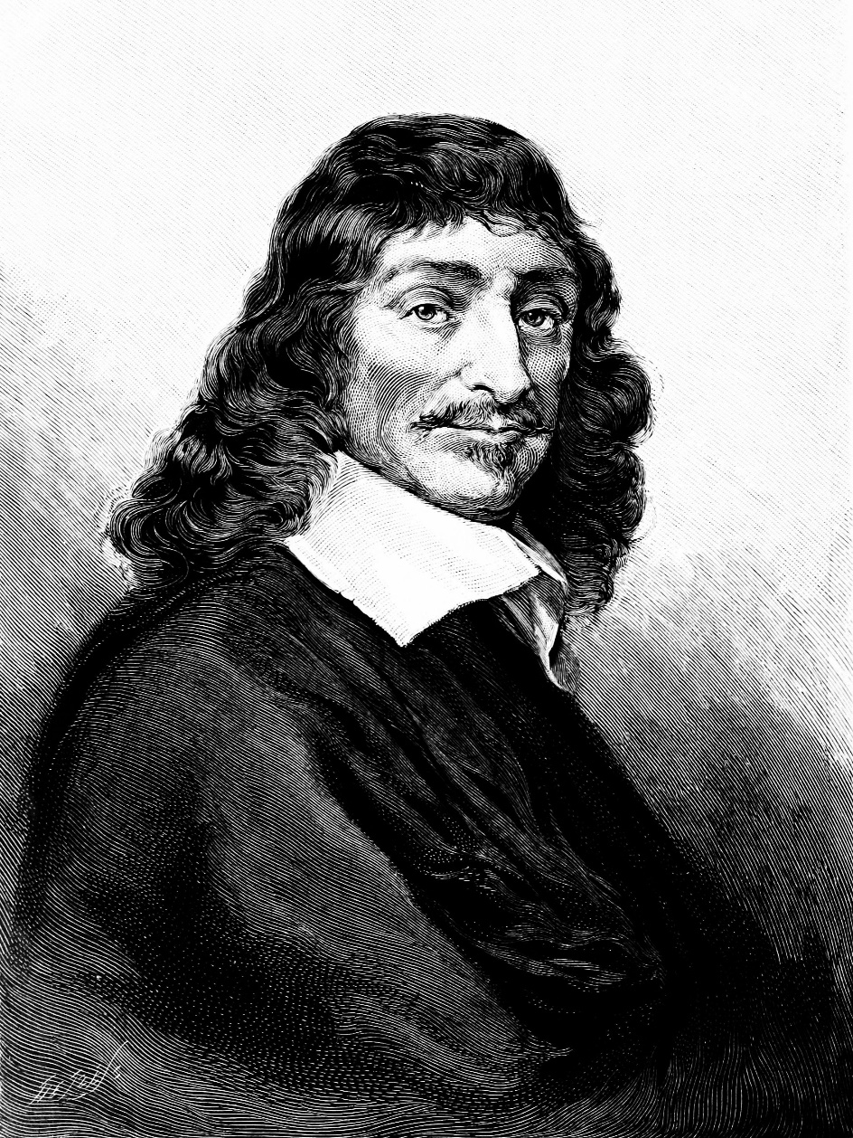
Descartes

Slide 11
Analytic geometry
point → coordinates
point sets (straight line, line segment, plane, circle, sphere) → equations
intersection → solution of a system of equations
translation, rotation, reflection, scaling → coordinate transformations
Notes:
In computer graphics, we should also take into account that a computer is programmed, which cannot do anything else but calculate with numbers. A computer is definitely not able to understand abstract concepts like point, line etc. So for the application of a computer, geometric concepts must be translated to numbers, calculation and algebra.
A geometry based on algebra, equations and numbers is called analytic geometry or coordinate geometry. To establish an analytic version of a geometry, we have to find correspondences between geometric concepts and concepts of algebra in a way that axioms of the geometry will not contradict to the concepts of algebra. If it is done, we can forget the original axioms and work only with numbers and equations.

Slide 12



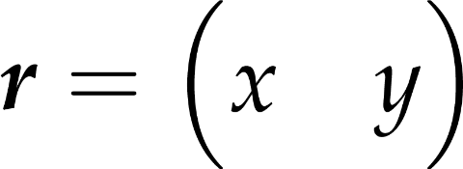
Cartesian coordinate system
1
Notes:
We need to associate number with points. Let us talk 2D first.
If we specify two orthogonal lines, we can measure the distance between both lines and a point. If we also specify a unit of length, the two distances can be expressed using numbers. These two numbers are the Cartesian coordinates of the point in the plane.
Note that the axes (lines) can also be given by their intersection point and their directions. Thus, a Cartesian coordinate system can also be established by picking an origin and the base vectors, the directions of which are the axis directions. Their length gives the unit length.

Slide 13





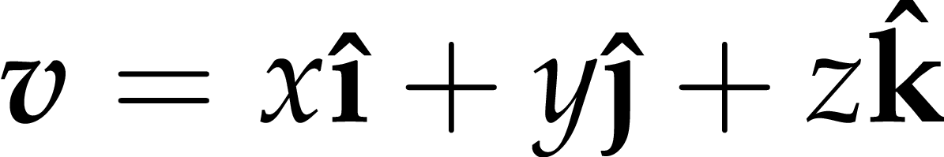

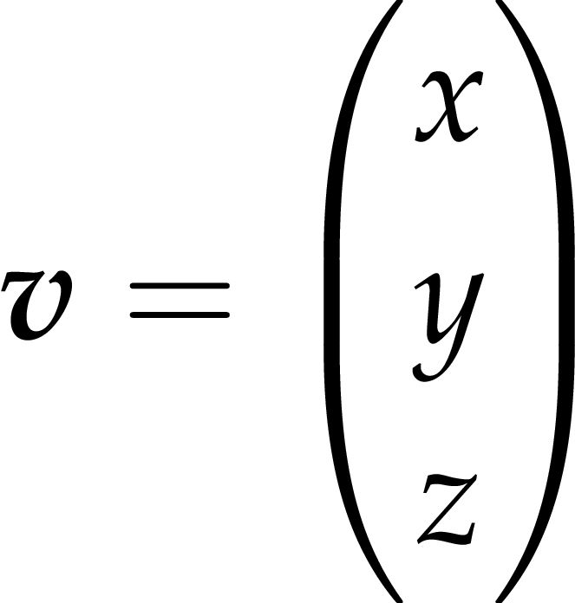
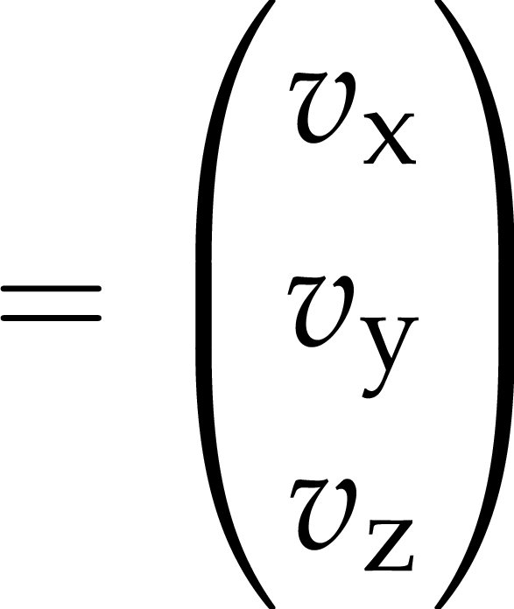

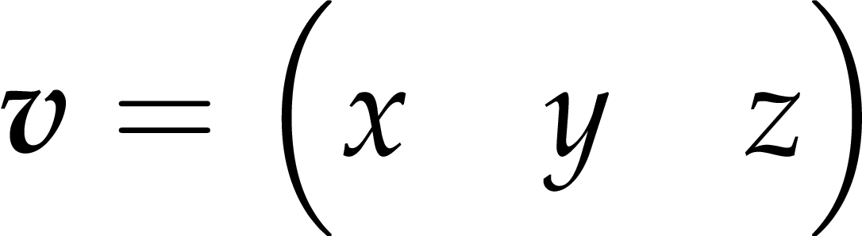
Vectors in 3D Cartesian
base vectors of the
Cartesian coordinate system
position can be expressed
as a linear combination of the base vectors
row vector
column vector
Notes:
A 3D Cartesian coordinate system can be defined with an origin and the basis vectors i, j, and k. Given an origin, a point is associated to a position vector, and a position vector can be expressed as a linear combination of the basis vectors. The linear coefficients are what we call the coordinates. Thus, a geometric vector is associated with a tuple of coordinate values: in this case, 3-tuples, or triples.
In linear algebra, tuples can be represented by one-row or one-column matrices, also called row vectors and column vectors. Both are the representations of the same geometric vector, so for geometric vector operations, it is just a matter of convention which form we use.
For Cartesian 3D (or 2D) vectors, we use parentheses around the elements, and sometimes separate them with commas for readability.
In the following slides, we give the interpretation of the vector operations on Cartesian coordinates. This way, the operations are instantly linked to programmable arithmetic.
We also give code snippets using the types float and vec3 realizing the operations. We assume appropriate operators and global functions are available.

Slide 14
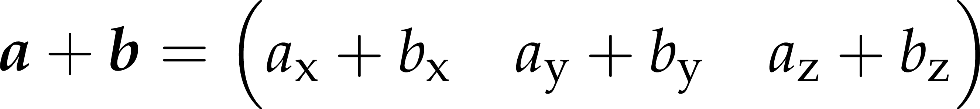
Vector addition
vec3 a;
vec3 b;
vec3 c = a+b;
GLSL
JavaScript
let a = new Vec3();
let b = new Vec3();
let sum = a.plus(b);
Notes:
Concerning vector operations, we can talk of addition that means the execution of the two translations one after the other. The resulting translation is independent of the order, so vector addition is commutative (parallelogram rule). If we have more than two vectors, parentheses can rearranged so it is also associative. Vector addition has an inverse, because we can ask which vector completes the translation of v2 to get a resulting translation v.

Slide 15
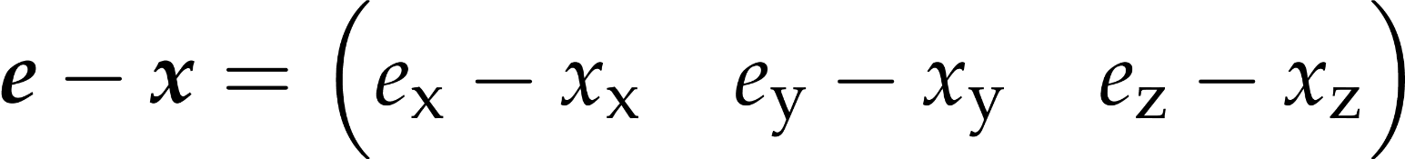



Vector difference
eye position
view direction
(non-normalized)
GLSL
vec3 pos;
vec3 eyePos;
vec3 viewDiff = eyePos – pos;
shaded surface
point’s position
let viewDiff = eyePos.minus(pos);
JavaScript
Notes:
Asking that question gives us vector difference.
Among its countless uses in graphics, taking the difference of two vectors has a prominent example in computing the view direction when a surface point and the eye position is known. The view direction is the direction of the difference vector. However, the length of this vector is of no interest, when only the view direction is required.

Slide 16
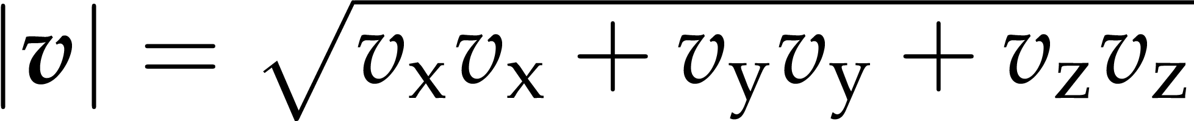
Vector length
eyeDist = length(viewDiff);
eyeDist = viewDiff.length();
Notes:
Cartesian vector length can be computed using the Pythagorean theorem.

Slide 17
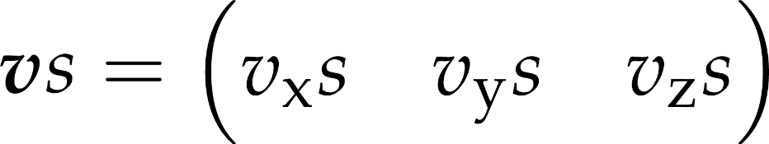
Scaling (vector times scalar)
sv
vec3 v;
vec3 vScaled = v * 1.5;
v
vScaled = v.times(1.5);
Notes:
The length of a vector can be modified by scaling – which is multiplication of a vector by a scalar. All coordinates are multiplied. The direction is unchanged – even though if the scalar is negative, the vector is reversed.

Slide 18
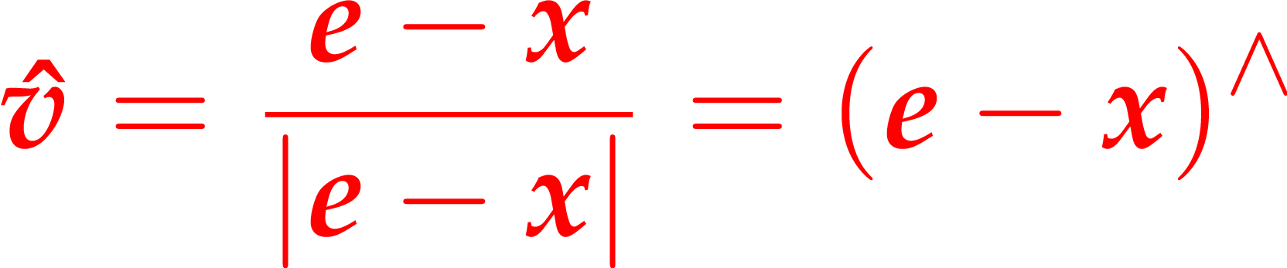
Normalization
float eyeDist =
length(viewDiff);
vec3 viewDir =
viewDiff / eyeDist;
OR
vec3 viewDir =
normalize(viewDiff);
eye position
view direction
(normalized)
viewDir =
viewDiff.direction();
shaded surface
point’s position
Notes:
In computer graphics, directions are most often represented by unit length vectors. If a direction is specified by a non-unit-length vector, but we want to use it in computations that assume unit length, we need to keep the direction, but change the length to one. This can be done by scaling the vector with the reciprocal of its length. This is called normalization, and the result is a normalized vector of unit length.

Slide 19
Discussed later
the dot product
a scalar-valued product of two vectors
used extensively in shape modeling
appears in all shading formulas
incredibly useful for animation, physics and AI
the cross product
product is a vector perpendicular to both operands
useful for finding orthogonal frames
for 3D camera
also useful for animation, physics, and AI
elementwise product

Slide 20
WebGLMath library
complete source for transparent debugging
WebGL's uniforms reflected
float as Vec1, vec2 as Vec2, vec3 as Vec3, vec4 as Vec4
arrays: Vec1Array, Vec3Array, Vec3Array, Vec4Array
texture samplers: Sampler2D, SamplerCube
all objects have a commit method to pass data into a uniform

Slide 21
Vector objects in JavaScript
no inlining: method calls have overhead!
only dinamic instantiation: expensive!
whatever looks as nice as C++ with operator overloads is not going to be performant
no operator overload
never actually going to be pretty

Slide 22
Vector objects in Kotlin
we have operator overload
reads nicely
still compiles to JS, not very fast
optimization is more challenging (but we do not care)

Slide 23
Simple 2d vector class
class Vec2(val x: Float = 0.0f, val y: Float = 0.0f){
operator inline fun plus(other : Vec2) : Vec2 {
return Vec2(
x + other.x,
y + other.y
)
}
fun toArray(dest : Float32Array){...}
}
usual init [OK]
usual instantiation [OK]
JS number arithmetics [SLOW]
WebGL interoperability [circumspect, slow]

Slide 24
Using a typed array
//a = b + c
val a = b + c
class Vec2(u: Float = 0.0f, v: Float = 0.0f){
val storage: Float32Array
operator inline fun plus(other : Vec2) : Vec2 {
return Vec2(
storage.x + other.storage.x,
storage.y + other.storage.y
)
}
}
typed new [very slow]
float arithmetics [fast]
WebGL interoperability is trivial

Slide 25
Coordinate getters/setters
inline var x : Float
get() = storage[0]
set(value) { storage[0] = value }
inline var y : Float
get() = storage[1]
set(value) { storage[1] = value }

Slide 26
Avoid new: assignment operator
operator fun plusAssign(other : Vec2) {
storage[0] += other.storage[0]
storage[1] += other.storage[1]
}
// a = b + c
a.set(b)
a += c
//jsperf: 3x gyorsabb, mint val a = b + c

Slide 27
Vector array types
GLSL also has them
we need them in Kotlin to directly set vector-array typed uniforms
we want them indexable
operations on arrays
done in single function call
fast arithmetics

Slide 28
Indexability
a[2]
class Vec2Array() : VecArray() {
operator fun get(i : Int) : Vec2{
return Vec2(storage, i*2)
}
}
class Vec2(backingStorage: Float32Array?, offset: Int = 0) {
constructor(u: Float = 0.0f, v: Float = 0.0f) : this(null, 0){
storage[0] = u
storage[1] = v
}
val storage: Float32Array =
backingStorage?.subarray(offset, offset+2)
?:Float32Array(2)

Slide 29
Swizzle
class Vec4(backingStorage: Float32Array?, offset: Int = 0) {
var xy : Vec2
get() = Vec2(storage)
set(value) { Vec2(storage).set(value) }
var xyz : Vec3
get() = Vec3(storage)
set(value) { Vec3(storage).set(value) }

Slide 30
Use vectors
!
make Scene's property avatarPosition a Vec3
try Vec3's methods to change avatarPosition
although changing x, y, z individually still works
use method commit to upload to uniform
you still need to acquire the uniform handle from the program
pay attention to parametrization of commit(gl, handle)
you still need to pay attention to the uniform variable in the shader and your js object being compatible
(we will automate this later with program reflection)
but you do not need to look up the proper gl.uniform* method

Slide 31
A little bit of game physics
!
add new Scene property avatarVelocity, a Vec3
instead of increasing/decreasing avatarPosition coordinates, change those of avatarVelocity
this means keypresses now produce acceleration
use Vec3’s += operator to add distance travelled to avatarPosition
distance travelled = velocity x time elapsed

